Slide 1
9 pm EST Monday 10 Dec 2024
Data science Quiz

Slide 2
Gemini-1.5-pro Team
1 Monish V Y
2 Pruthvi Raj G Y
3 Vamsi G Y
5 Babitha B Y
GPT-4o Team
6 Pranav Gattu
7 Kalyan Gattu Y
8 S Soujanya Y
9 Sri Latha Tatineni Y
4 Srishanth K Y

Slide 3
 | Gemini-1.5-pro Team |  | GPT-4o Team
1 | 1 |  | 1
2 | 1 |  | 1
3 | 1 |  | 1
4 | 1 |  | 1
5 | 1 |  | 1

Slide 4
9 pm EST Tuesday 10 Dec 2024
Decision Tree

Slide 5
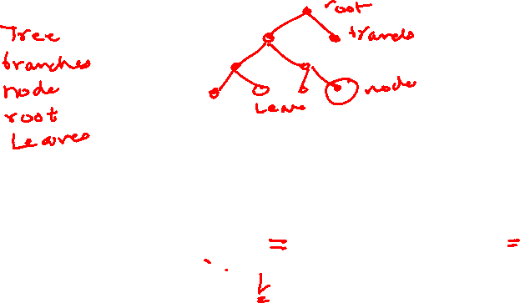
Decision Tree – Entropy and Gini Index

Slide 6
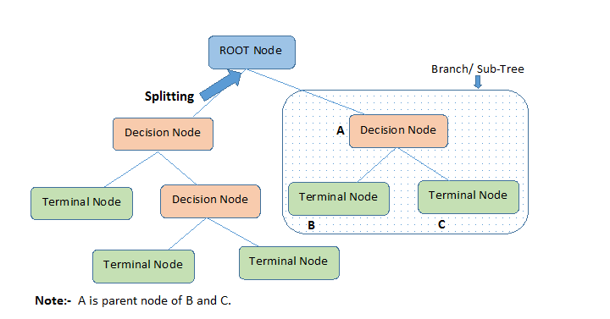

Slide 7
Definitions
Root Node: It represents entire population or sample and this further gets divided into two or more homogeneous sets.
Splitting: It is a process of dividing a node into two or more sub-nodes.
Decision Node: When a sub-node splits into further sub-nodes, then it is called decision node.
Leaf/ Terminal Node: Nodes with no children (no further split) is called Leaf or Terminal node.

Slide 8
Definitions
Pruning: When we reduce the size of decision trees by removing nodes (opposite of Splitting), the process is called pruning.
Branch / Sub-Tree: A sub section of decision tree is called branch or sub-tree.
Parent and Child Node: A node, which is divided into sub-nodes is called parent node of sub-nodes where as sub-nodes are the child of parent node.

Slide 9
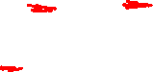
Types of Algorithms in Decision Tree
Algorithm used in decision trees:
entropy, Information Gain
Gini Index

Slide 10
Entropy and Information Gain

Slide 11
Entropy and Information Gain
Entropy :
A measure of Homogeneity of the set of examples
If the sample is completely homogeneous the entropy=0 and if the sample is equally divided it has entropy =1
Information Gain:
Measures how well an given attribute separates the training examples according to their target classification
This measure is used to select among the candidate attributes at each step while growing the tree

Slide 12
Entropy
Entropy is used for calculating Information gain.
Entropy : A decision tree is built top-down from a root node and involves partitioning the data into subsets that contain instances with similar values (homogeneous).
Entropy is used for measuring Impurity
If the sample is completely homogeneous the entropy is zero (If your data is matching- that means no impurity)
If the sample is equally divided then it has entropy of one. (contains equal divisions of different data). No matching data. Then Impurity is high so entropy is 1.

Slide 13
Information Gain
The information gain is the decrease in entropy after a dataset is split the basis of an attribute.
Constructing a decision tree is all about finding attribute that returns the highest information gain. That is split at the attribute that has the highest information gain.
Information gain is calculated based on entropy.

Slide 14
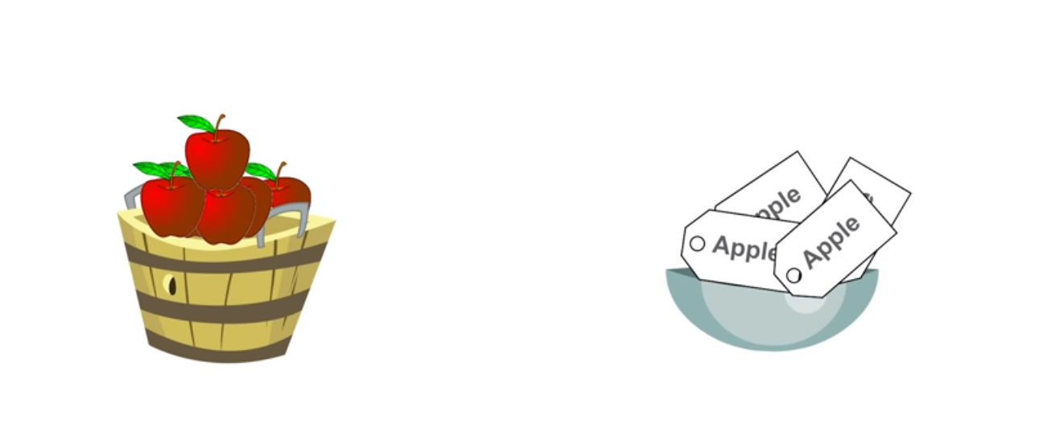
What is Impurity (in Entropy)

Slide 15
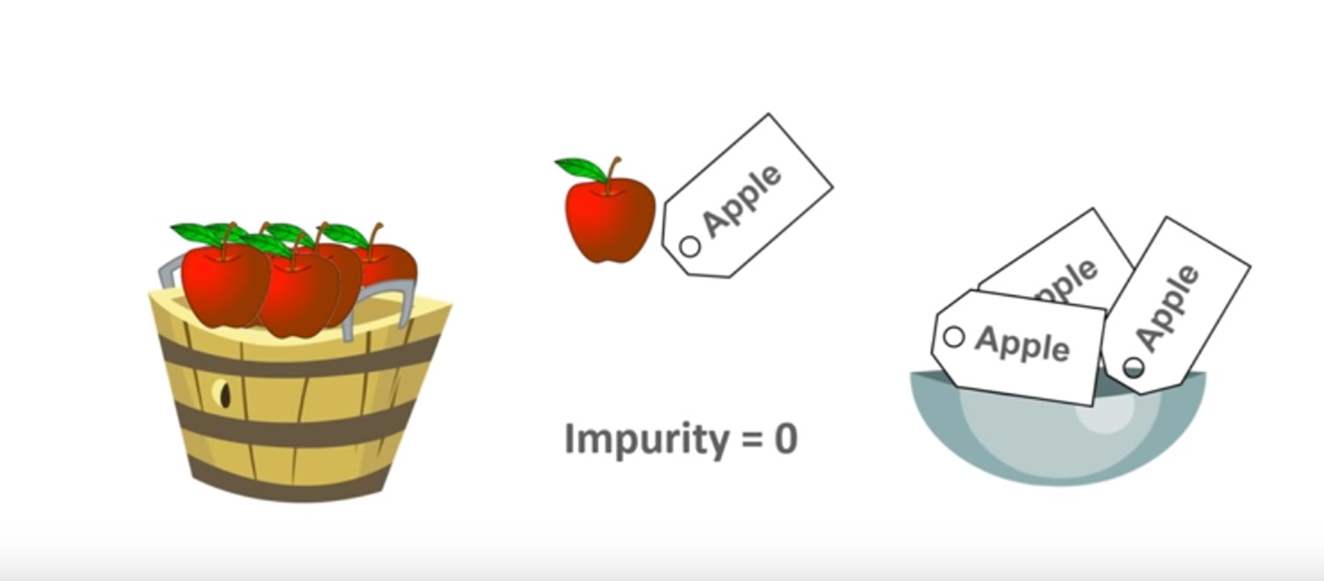
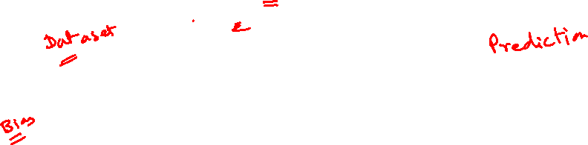
TASK: FRUITS should have matching Labels
Example: Apples should have the same label (Apples).
If you have to pick Apples and Labels from 2 baskets, you will always get matching labels. So the impurity is 0
Impurity is also the degree of Randomness. In the Basket the degree of Randomness is Less, so impurity is zero
Entropy is 0
Because Apple and Apple Label Match

Slide 16
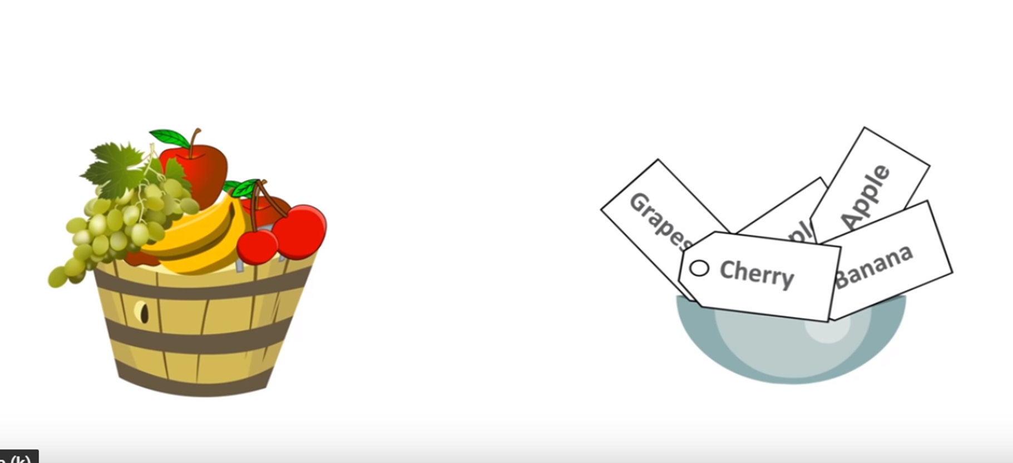
TASK: FRUITS should have matching Labels
Example: Apples should have the same label (Apples).
If you have 2 baskets with different fruits and different labels.
If you have to pick any Random FRUIT or LABEL , it may or may not match

Slide 17
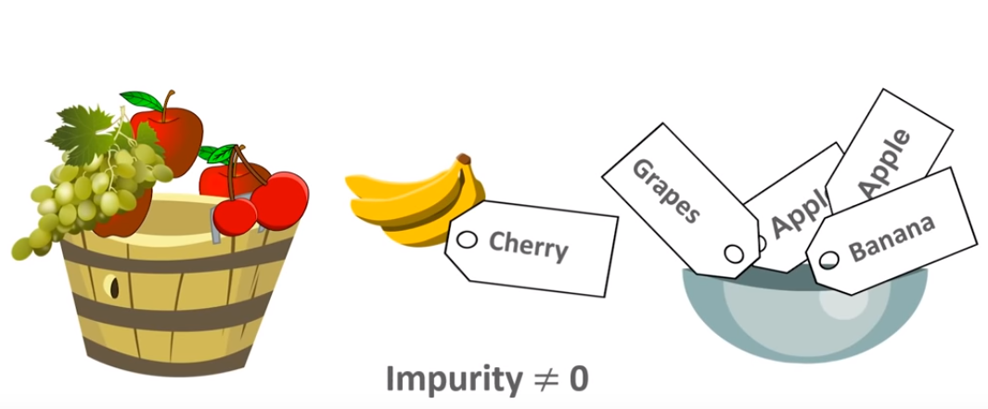
TASK: FRUITS should have matching Labels
Example: Apples should have the same label (Apples).
It may happen a Banana is match with a Cherry Label
So impurity is not equal to zero
Entropy not equal to 0
Entropy is more than 0 or closer to 1
Because Fruits and Label Do not Match

Slide 18
Another Example of Entropy
Let us say you have a bag of balls.
You grab one ball from the bag and put it on the table. How many ways can you arrange that ball? The answer: one way.
What if we grab two balls and ask the same question? Now there are more ways to arrange the two balls.
We keep doing this until all the balls are on the table. At this point, there are so many ways to arrange the bag of balls, you might not even be able to count the number of ways.
This situation is very much like entropy.
The higher the entropy (meaning the more ways the system can be arranged), the more the system is disordered.

Slide 19
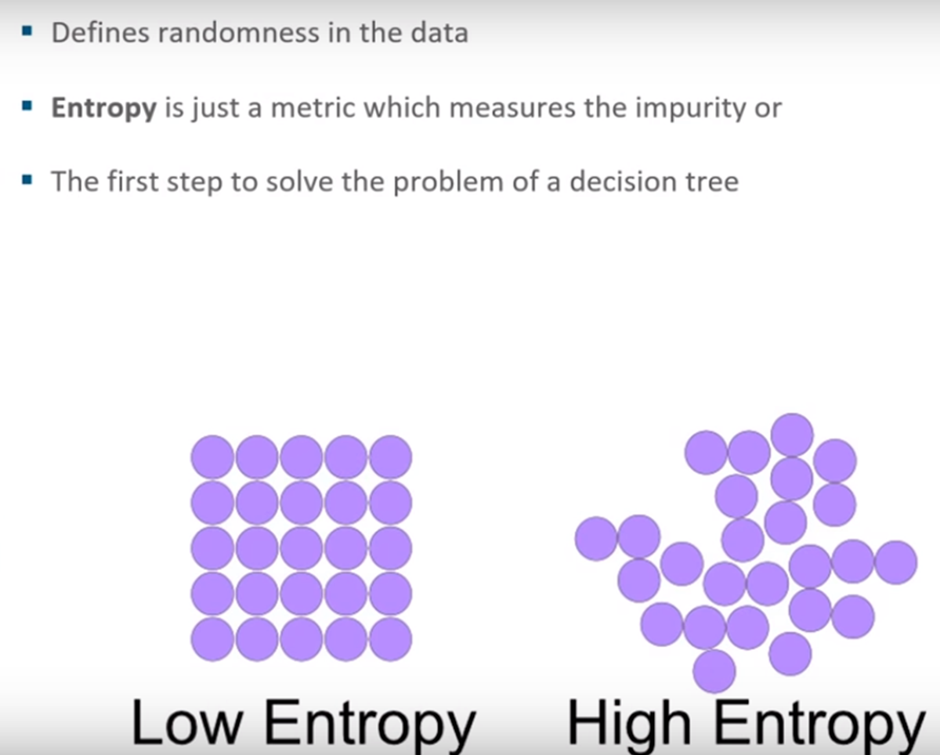
Entropy
Data Contains all Yes
Data Contains similar Types
More Pure
Data Contains mix of Yes and No
Data Contains Mix Types
Less Pure

Slide 20
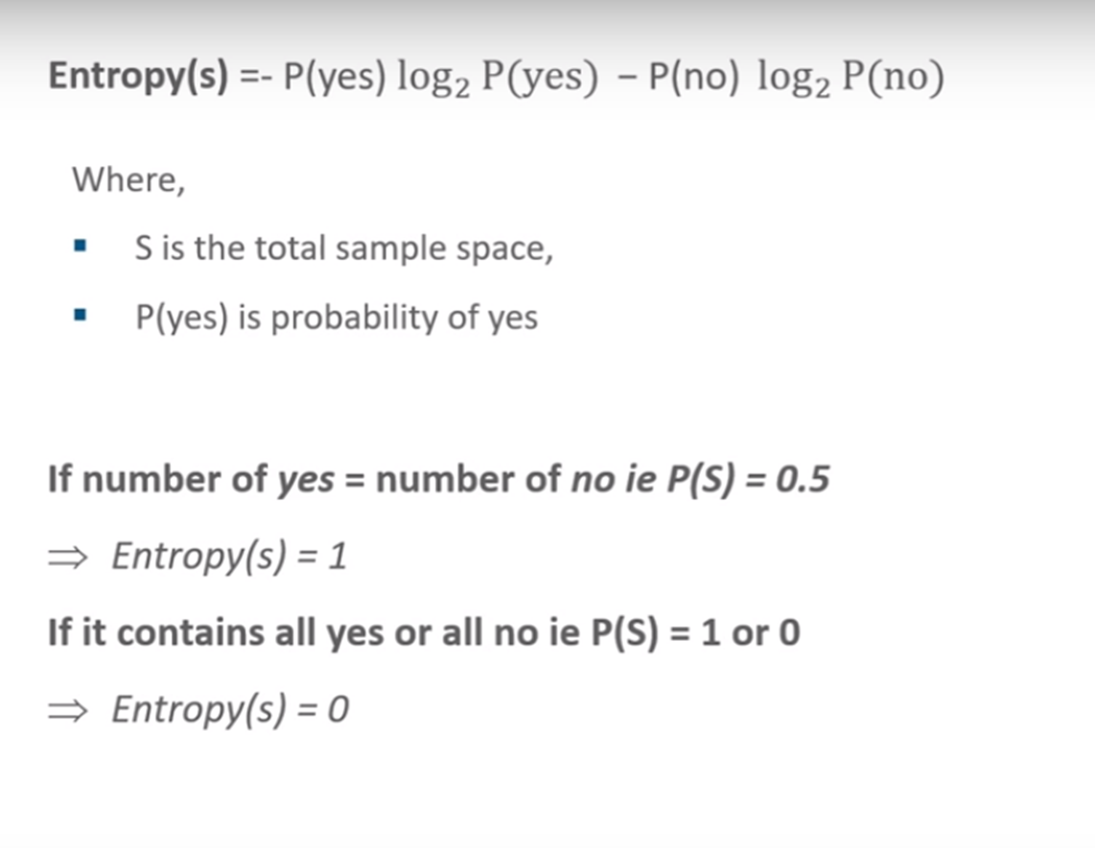
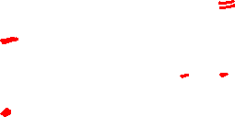
Entropy

Slide 21
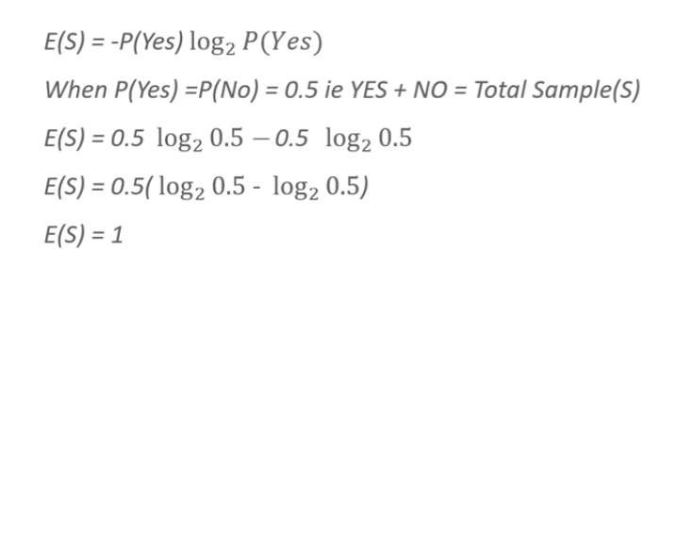
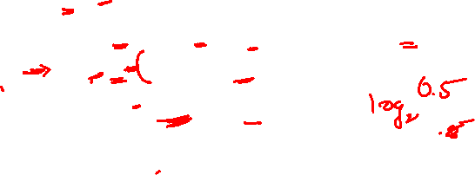
Half Yes, Half No, Entropy =1

Slide 22
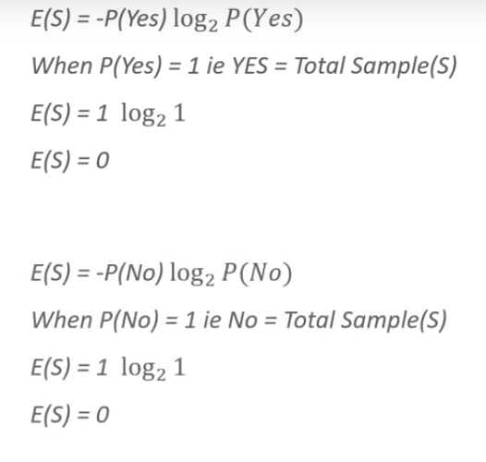

[Total Yes] or [Total No] Entropy] =0
Value of Log 1 is zero
Value of Log 1 is zero

Slide 23
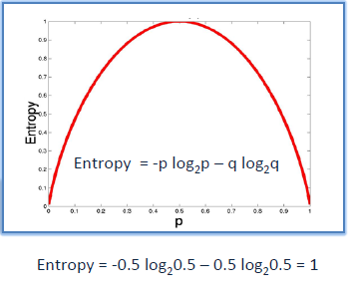
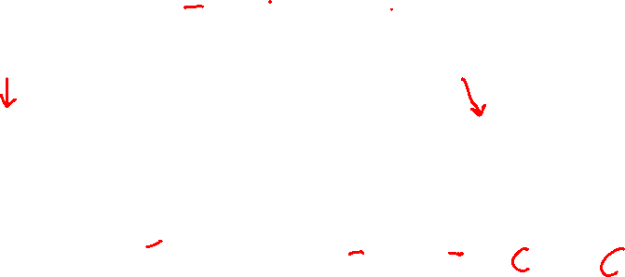
Entropy
Entropy = 0
Entropy = 1
Highly Pure
Highly Impure
Data is Pure, Randomness = 0
Data is of the Same Type, All Yes
Data is Impure, Randomness is high
Data is of the 2 Types, Half Yes + Half No

Slide 24
Entropy

Slide 25
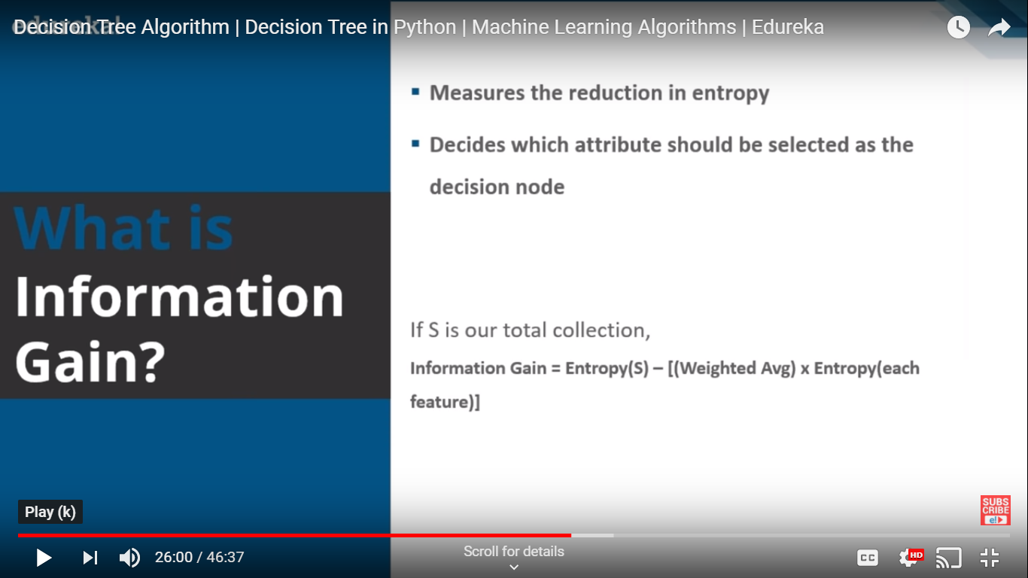

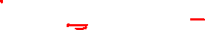
Information Gain

Slide 26
Decision Tree – Play Golf

Slide 27
Decision Tree
To predict if a player will play golf that day based on the weather (Outlook, Temperature, Humidity, Windy).

Slide 28
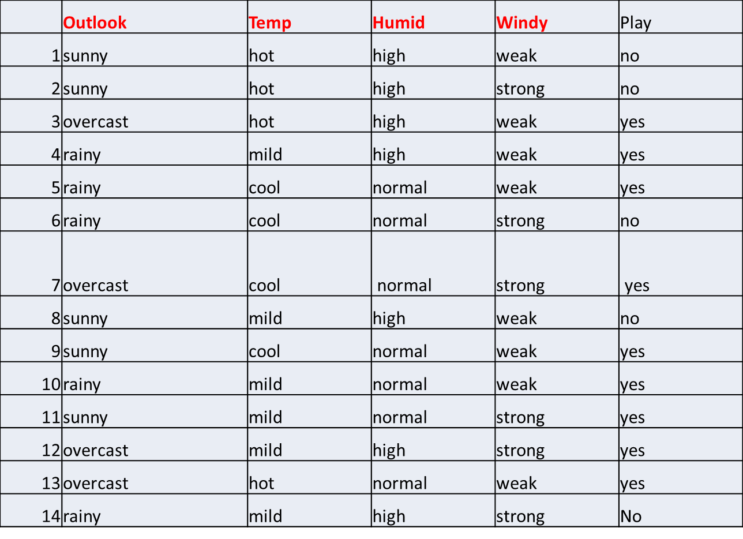
Predictors
Target

Slide 29
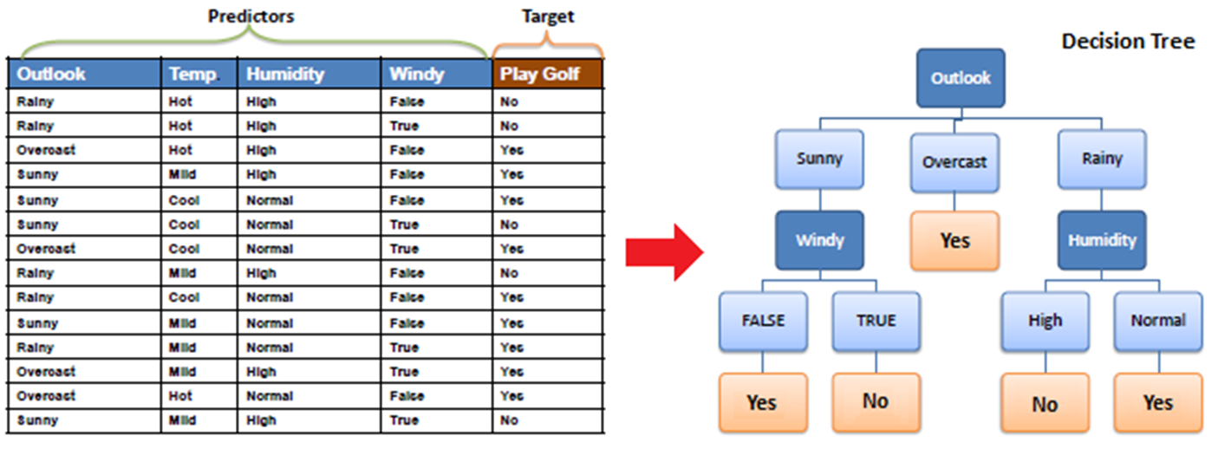
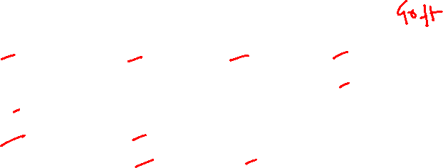
 | Outlook | Temp | Humid | Windy | Play
1 | sunny | hot | high | weak | no
2 | sunny | hot | high | strong | no
3 | overcast | hot | high | weak | yes
4 | rainy | mild | high | weak | yes
5 | rainy | cool | normal | weak | yes
6 | rainy | cool | normal | strong | no
7 | overcast | cool | normal | strong | yes
8 | sunny | mild | high | weak | no
9 | sunny | cool | normal | weak | yes
10 | rainy | mild | normal | weak | yes
11 | sunny | mild | normal | strong | yes
12 | overcast | mild | high | strong | yes
13 | overcast | hot | normal | weak | yes
14 | rainy | mild | high | strong | No

Slide 30
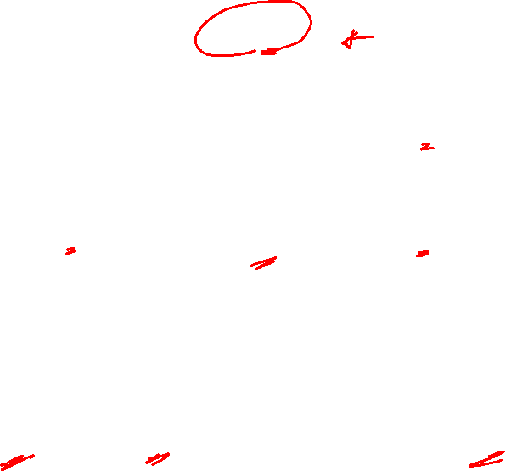
We need to build a Decision Tree, how to Select the Nodes?

Slide 31
Weather Data
 | Outlook | Temp | Humid | Windy | Play
1 | sunny | hot | high | weak | no
2 | sunny | hot | high | strong | no
3 | overcast | hot | high | weak | yes
4 | rainy | mild | high | weak | yes
5 | rainy | cool | normal | weak | yes
6 | rainy | cool | normal | strong | no
7 | overcast | cool | normal | strong | yes
8 | sunny | mild | high | weak | no
9 | sunny | cool | normal | weak | yes
10 | rainy | mild | normal | weak | yes
11 | sunny | mild | normal | strong | yes
12 | overcast | mild | high | strong | yes
13 | overcast | hot | normal | weak | yes
14 | rainy | mild | high | strong | No

Slide 32
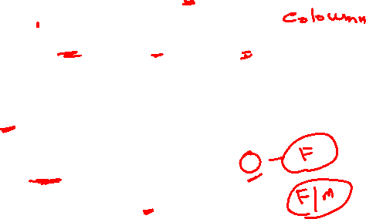
Entropy – Information Gain Steps
Step 1: Calculate entropy of the target (Play Golf) =.94
Step 2: Calculate Entropy and then information gain for each attribute
Step 3: Chose the attribute with the largest information gain as the decision node (Outlook Gain =0.247)
Step 4a: A Branch with Entropy of 0 is a leaf node
Step 4b: A Branch with Entropy of more than 0 needs further splitting
Step 5: The algorithm is run recursively on the non-leaf branches until all data is classified

Slide 33
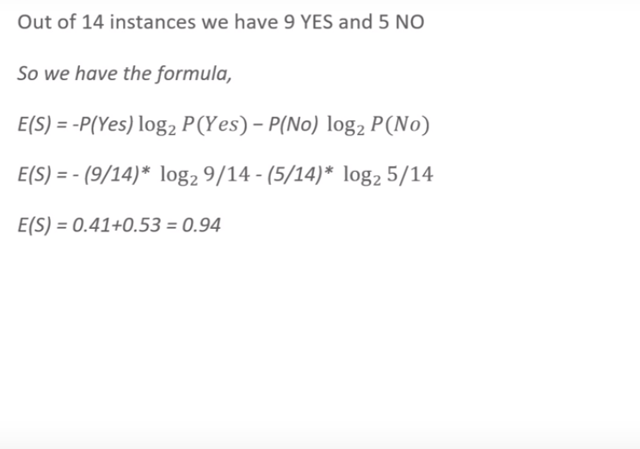
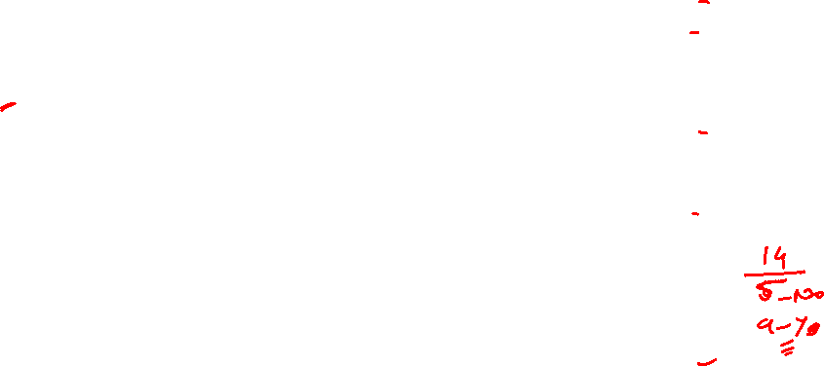
Compute Entropy Of Target (Play) Rows = 14
 | Outlook | Temp | Humid | Windy | Play
1 | sunny | hot | high | weak | no
2 | sunny | hot | high | strong | no
3 | overcast | hot | high | weak | yes
4 | rainy | mild | high | weak | yes
5 | rainy | cool | normal | weak | yes
6 | rainy | cool | normal | strong | no
7 | overcast | cool | normal | strong | yes
8 | sunny | mild | high | weak | no
9 | sunny | cool | normal | weak | yes
10 | rainy | mild | normal | weak | yes
11 | sunny | mild | normal | strong | yes
12 | overcast | mild | high | strong | yes
13 | overcast | hot | normal | weak | yes
14 | rainy | mild | high | strong | No
E(S) = 0.94
Entropy of the entire datset = 0.94
Step 1: Calculate entropy of the target (Play Golf) =.94

Slide 34
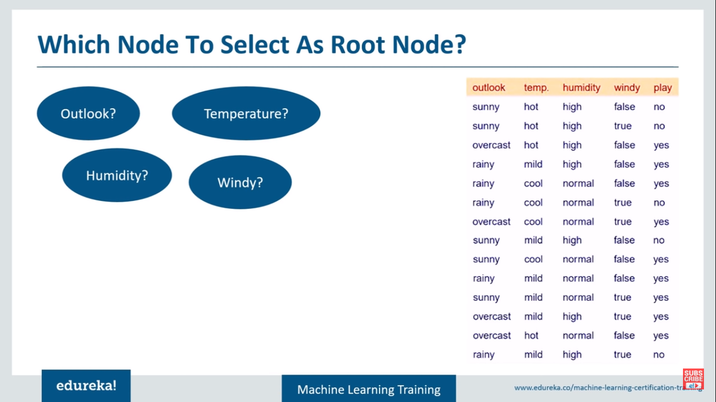
Which Node to select as Root Node
 | Outlook | Temp | Humid | Windy | Play
1 | sunny | hot | high | weak | no
2 | sunny | hot | high | strong | no
3 | overcast | hot | high | weak | yes
4 | rainy | mild | high | weak | yes
5 | rainy | cool | normal | weak | yes
6 | rainy | cool | normal | strong | no
7 | overcast | cool | normal | strong | yes
8 | sunny | mild | high | weak | no
9 | sunny | cool | normal | weak | yes
10 | rainy | mild | normal | weak | yes
11 | sunny | mild | normal | strong | yes
12 | overcast | mild | high | strong | yes
13 | overcast | hot | normal | weak | yes
14 | rainy | mild | high | strong | No
Step 2: Calculate information gain for each attribute

Slide 35
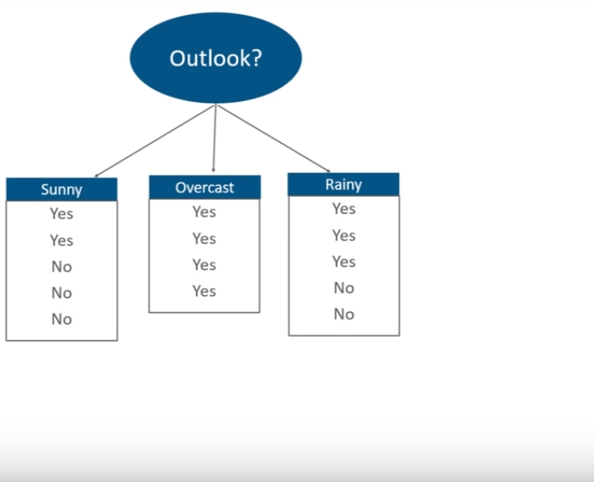
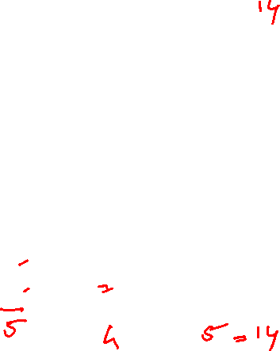
Calculated Entropy and Information Gain for Each Node
Start with
 | Outlook | Temp | Humid | Windy | Play
1 | sunny | hot | high | weak | no
2 | sunny | hot | high | strong | no
3 | overcast | hot | high | weak | yes
4 | rainy | mild | high | weak | yes
5 | rainy | cool | normal | weak | yes
6 | rainy | cool | normal | strong | no
7 | overcast | cool | normal | strong | yes
8 | sunny | mild | high | weak | no
9 | sunny | cool | normal | weak | yes
10 | rainy | mild | normal | weak | yes
11 | sunny | mild | normal | strong | yes
12 | overcast | mild | high | strong | yes
13 | overcast | hot | normal | weak | yes
14 | rainy | mild | high | strong | No
Y=2
N=3
Y=4
Y=3
N=2
Play

Slide 36
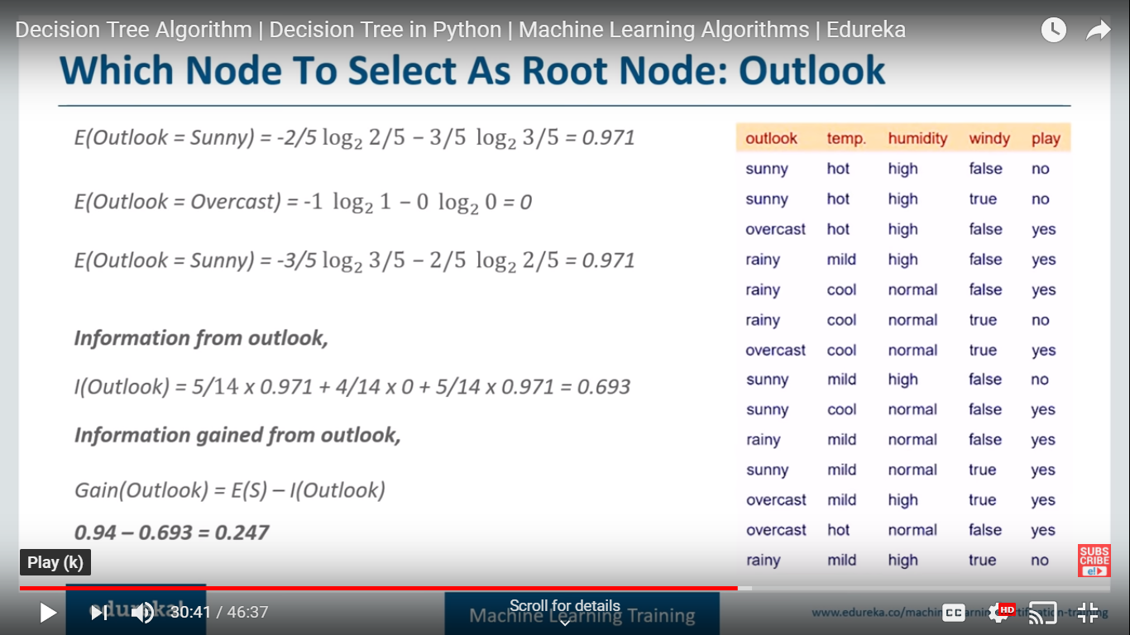

Which Node to select as Root Node: Outlook
Let us Consider Outlook as Node
0
Rainy
Step 2: Calculate information gain for each attribute

Slide 37
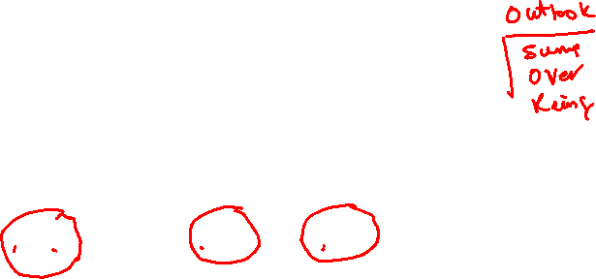
Information Gain for : Outlook
Weighted Avg (Sunny) = 5/14 , Entropy(Sunny) = .971
Sunny
Overcast
Rainy
0.247 = 0.94 – 0.693
Entropy of the datset
Step 2: Calculate information gain for each attribute

Slide 38
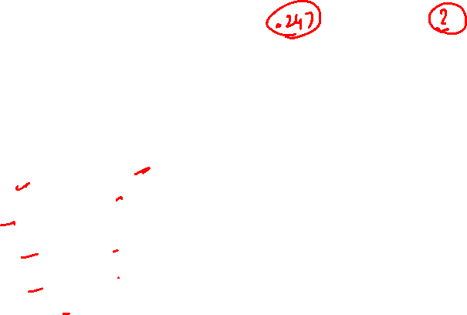
Which node to select as Root Node ? Windy
windy
 | Outlook | Temp | Humid | Windy | Play
1 | sunny | hot | high | weak | no
2 | sunny | hot | high | strong | no
3 | overcast | hot | high | weak | yes
4 | rainy | mild | high | weak | yes
5 | rainy | cool | normal | weak | yes
6 | rainy | cool | normal | strong | no
7 | overcast | cool | normal | strong | yes
8 | sunny | mild | high | weak | no
9 | sunny | cool | normal | weak | yes
10 | rainy | mild | normal | weak | yes
11 | sunny | mild | normal | strong | yes
12 | overcast | mild | high | strong | yes
13 | overcast | hot | normal | weak | yes
14 | rainy | mild | high | strong | No
Play
Yes=3
No=3
Yes=6
No=2
Step 2: Calculate information gain for each attribute

Slide 39
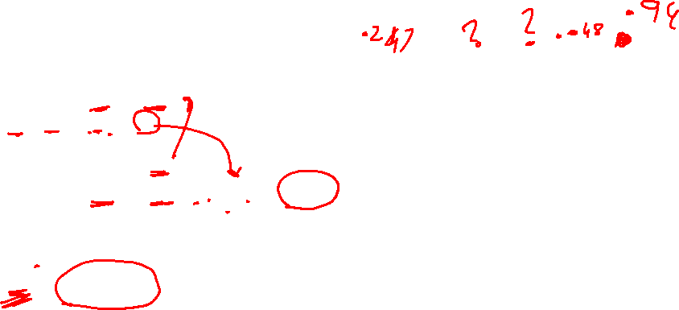
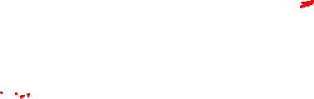
Information Gain for : Windy
 | Outlook | Temp | Humid | Windy | Play
1 | sunny | hot | high | weak | no
2 | sunny | hot | high | strong | no
3 | overcast | hot | high | weak | yes
4 | rainy | mild | high | weak | yes
5 | rainy | cool | normal | weak | yes
6 | rainy | cool | normal | strong | no
7 | overcast | cool | normal | strong | yes
8 | sunny | mild | high | weak | no
9 | sunny | cool | normal | weak | yes
10 | rainy | mild | normal | weak | yes
11 | sunny | mild | normal | strong | yes
12 | overcast | mild | high | strong | yes
13 | overcast | hot | normal | weak | yes
14 | rainy | mild | high | strong | No
E(Windy=Weak)=0.811
E(Windy=Strong)=1
Information from Windy:
I(Windy) = 8/14 x 0.811 + 6/14 x 1 = 0.892
Information Gain from Windy:
Gain(Windy) = E(S) - I(Windy)
0.048 = 0.94 -0.892
Step 2: Calculate information gain for each attribute

Slide 40
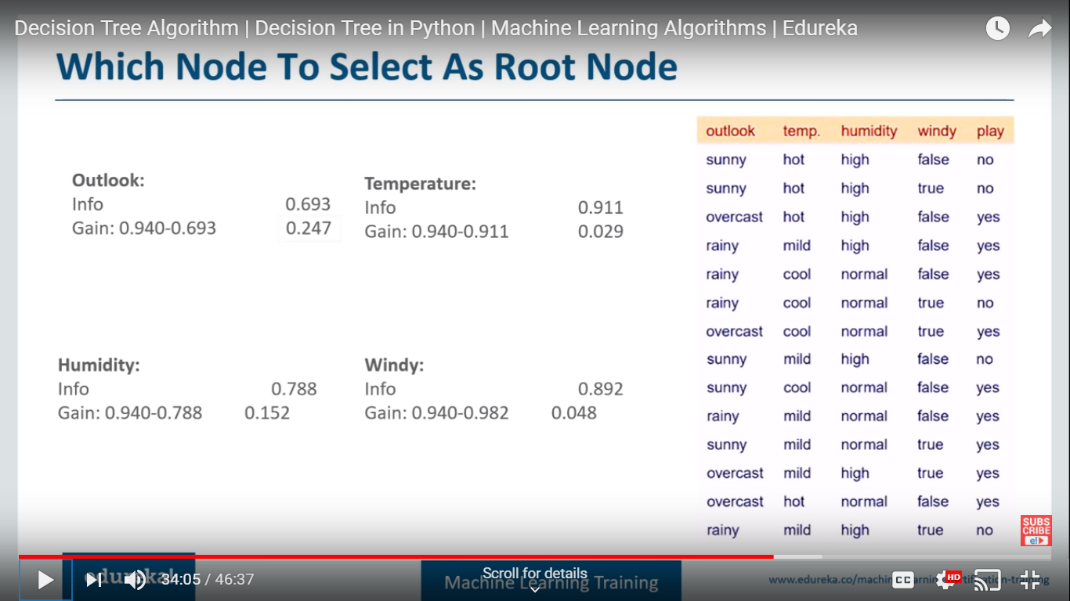

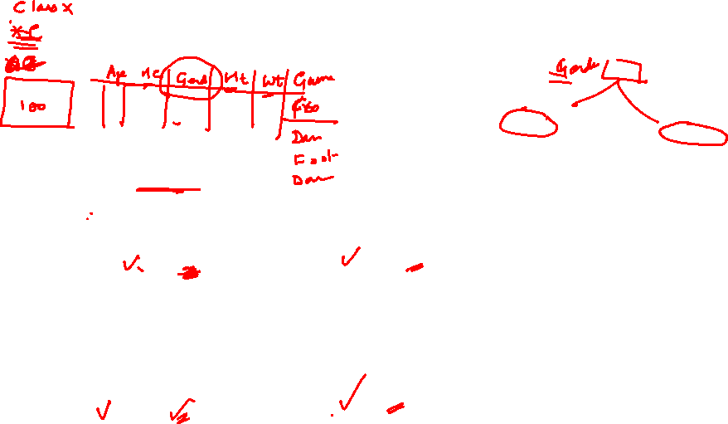
Calculate the Info Gain for all the nodes
Entropy of Total dataset : .940
 | Outlook | Temp | Humid | Windy | Play
1 | sunny | hot | high | weak | no
2 | sunny | hot | high | strong | no
3 | overcast | hot | high | weak | yes
4 | rainy | mild | high | weak | yes
5 | rainy | cool | normal | weak | yes
6 | rainy | cool | normal | strong | no
7 | overcast | cool | normal | strong | yes
8 | sunny | mild | high | weak | no
9 | sunny | cool | normal | weak | yes
10 | rainy | mild | normal | weak | yes
11 | sunny | mild | normal | strong | yes
12 | overcast | mild | high | strong | yes
13 | overcast | hot | normal | weak | yes
14 | rainy | mild | high | strong | No
Outlook has maximum gain so it is our root node
Step 2: Calculate information gain for each attribute

Slide 41


Select the Node with highest Info Gain: Outlook
Entropy of Total dataset : .940
 | Outlook | Temp | Humid | Windy | Play
1 | sunny | hot | high | weak | no
2 | sunny | hot | high | strong | no
3 | overcast | hot | high | weak | yes
4 | rainy | mild | high | weak | yes
5 | rainy | cool | normal | weak | yes
6 | rainy | cool | normal | strong | no
7 | overcast | cool | normal | strong | yes
8 | sunny | mild | high | weak | no
9 | sunny | cool | normal | weak | yes
10 | rainy | mild | normal | weak | yes
11 | sunny | mild | normal | strong | yes
12 | overcast | mild | high | strong | yes
13 | overcast | hot | normal | weak | yes
14 | rainy | mild | high | strong | No
Outlook has maximum gain so it is our root node
Step 3: Chose the attribute with the largest information gain
as the decision node (Outlook Gain =0.247)

Slide 42
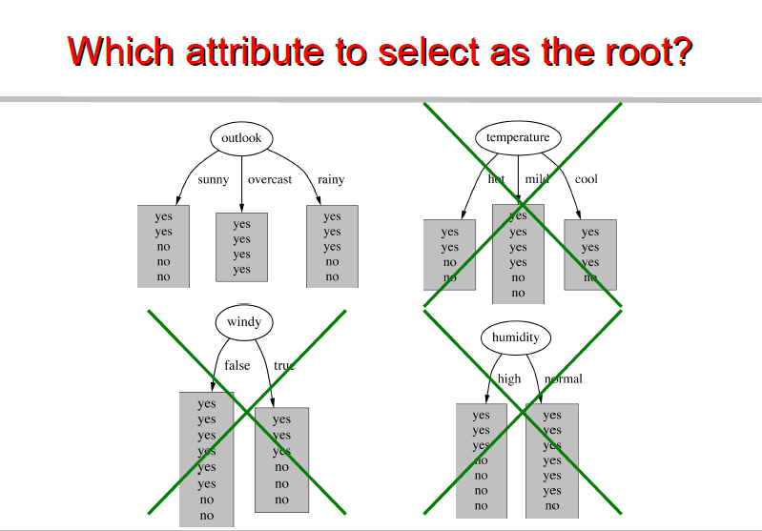
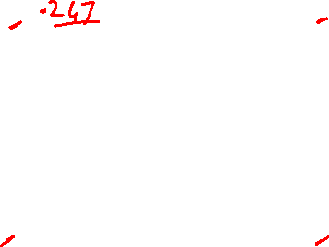
Select the node that gives more accurate answers

Slide 43
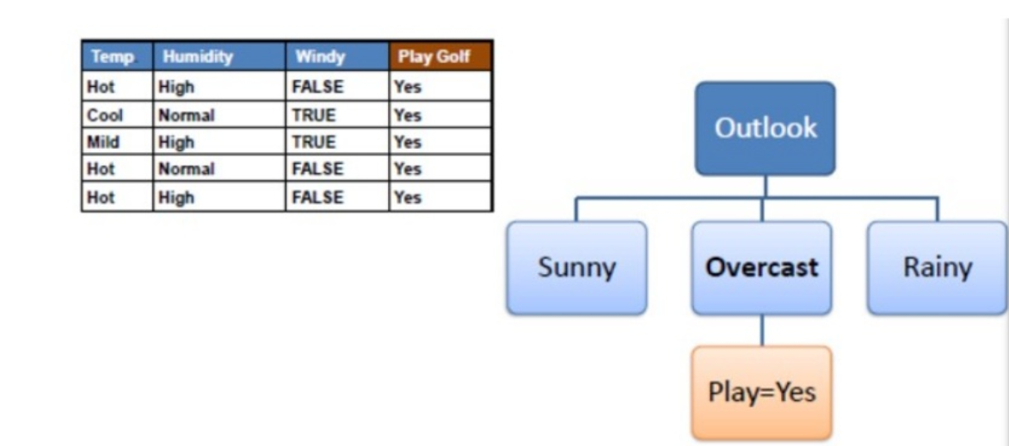
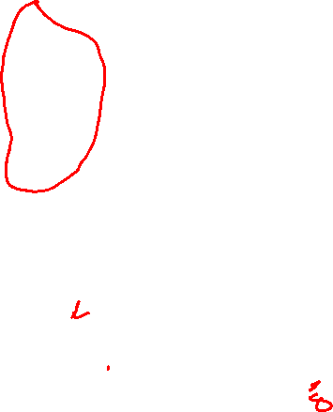

Step 4a: A Branch with Entropy of 0 is a leaf node

Slide 44
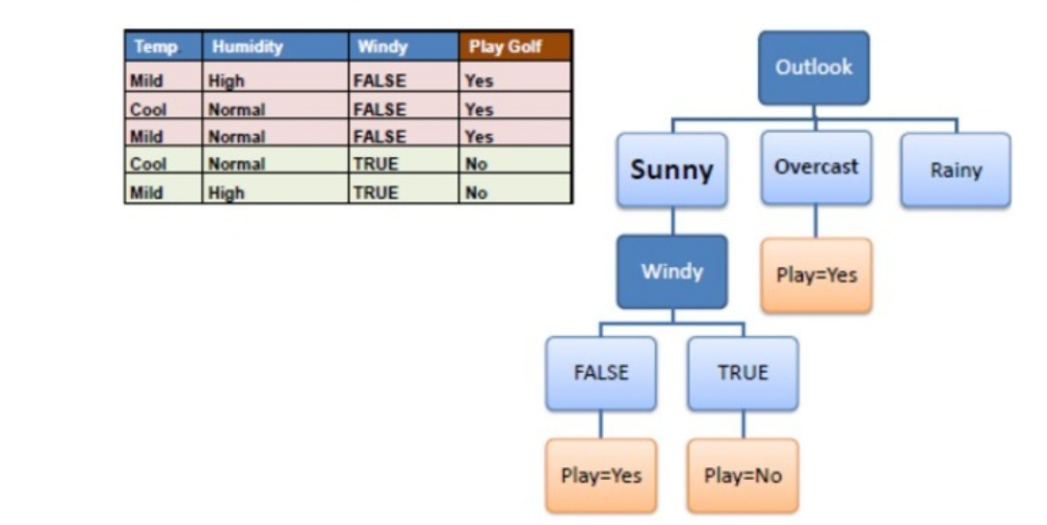

Step 4b: A Branch with Entropy of more than 0 needs further splitting

Slide 45
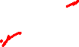
Step 5: The algorithm is run recursively on the non-leaf branches until all data is classified

Slide 46
End

Slide 47
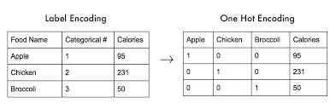
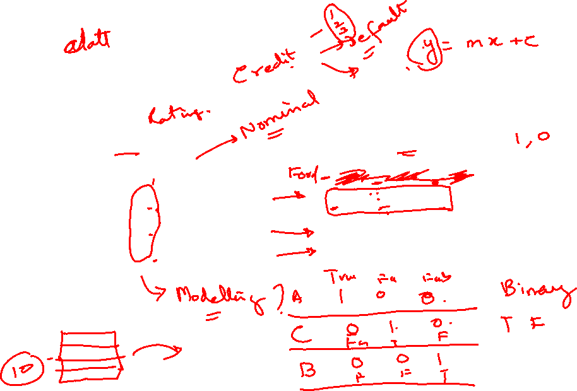

Slide 48
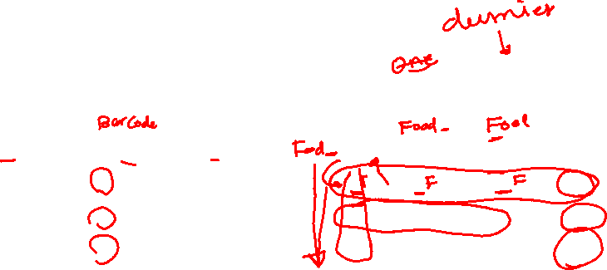

Slide 51
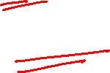
Gini Index

Slide 52
 | Outlook | Temp | Humid | Windy | Play
1 | sunny | hot | high | weak | no
2 | sunny | hot | high | strong | no
3 | overcast | hot | high | weak | yes
4 | rainy | mild | high | weak | yes
5 | rainy | cool | normal | weak | yes
6 | rainy | cool | normal | strong | no
7 | overcast | cool | normal | strong | yes
8 | sunny | mild | high | weak | no
9 | sunny | cool | normal | weak | yes
10 | rainy | mild | normal | weak | yes
11 | sunny | mild | normal | strong | yes
12 | overcast | mild | high | strong | yes
13 | overcast | hot | normal | weak | yes
14 | rainy | mild | high | strong | No

Slide 53
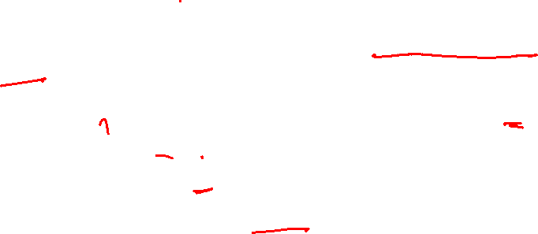
Gini Index
Gini index says, if we select two items from a population at random then they must be of same class and probability for this is 1 if population is pure.
It works with categorical target variable “Success” or “Failure”. (0 or 1) (Yes or No)
It performs only Binary splits
Higher the value of Gini higher the homogeneity.
CART (Classification and Regression Tree) uses Gini method to create binary splits.

Slide 54
Calculate Gini for a split
Calculate Gini for sub-nodes, using formula sum of square of probability for success and failure (p²+q²).
Calculate Gini for split using weighted Gini score of each node of that split

Slide 55
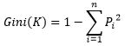
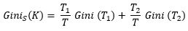
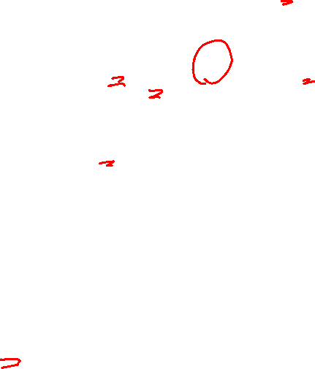
Gini index measures the impurity of a data partition K, formula for Gini Index can be written down as:
Where n is the number of classes, and P_{i} is the probability that an observation in K belongs to the class.
Gini Index assumes a binary split for each of the attribute in S, let say T₁ & T_{2.} The Gini index of K given this partitioning is given by:

Slide 56
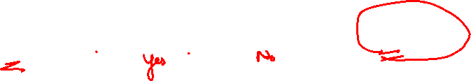
Calculate Gini Index
So as the first step we will find the root node of our decision tree. For that Calculate the gini index of the class variable (Play)
Gini(S) = 1 - [(9/14)² + (5/14)²] = 0.4591
Gini(S) = 1 - [(p)² + (q)²] = 0.4591
p=success=yes
q=failure=no

Slide 57
Gini Gain
we will calculate gini gain. For that first, we will find the average weighted gini impurity of Outlook, Temperature, Humidity and Windy.

Slide 58


Gini Gain - Outlook
Gini(S, outlook) = (5/14)gini(3,2) + (4/14)*gini(4,0)+ (5/14)*gini(2,3)
= (5/14)(1 – [(3/5)² + (2/5)²]) + (4/14)*0 + (5/14)(1 – [(2/5)² + (3/5)²])
= 0.171+0+0.171 = 0.342
Gini gain (S, outlook) = 0.459 - 0.342 = 0.117
Gini Index : Play

Slide 59

Gini Gain – For all Predictors
Gini gain (S, outlook) = 0.459 - 0.342 = 0.117
Gini gain(S, Temperature) = 0.459 - 0.4405 = 0.0185
Gini gain(S, Humidity) = 0.459 - 0.3674 = 0.0916
Gini gain(S, windy) = 0.459 - 0.4286 = 0.0304
Choose one that having higher gini gain.
Gini gain is higher for outlook .So we can choose it as our root node.

Slide 60

Split on Which Column?
Above, you can see that Gini score for Split on Outlook (0.117) is higher than Split on other Classes(Columns) hence, the node split will take place on Outlook

Slide 61
Cricket Example for Gini
there are 4 entries.

Slide 62
Steps to Calculate Gini for a split
Calculate Gini for sub-nodes, using formula sum of square of probability for success and failure (p²+q²).
Calculate Gini for split using weighted Gini score of each node of that split

Slide 63
Decision Tree for Cricket
Example: — Referring to example where we want to segregate the students based on target variable ( playing cricket or not ). In the snapshot below, we split the population using two input variables Gender and Class. Now, I want to identify which split is producing more homogeneous sub-nodes using Gini index.

Slide 64


Slide 65
Split on Gender or Class ?
Above, you can see that Gini score for Split on Gender is higher than Split on Class, hence, the node split will take place on Gender.

Slide 66
Gini Vs Entropy

Slide 67

Gini Vs Entropy
The Gini Index is calculated by subtracting the sum of the squared probabilities of each class from one. It favours larger partitions.
Information Gain multiplies the probability of the class times the log (base=2) of that class probability. Information Gain favors smaller partitions with many distinct values.
Ultimately, you have to experiment with your data and the splitting criterion.

Slide 68
End

Slide 70
9 pm EST Wednesday 11 Dec 2024
Random Forest
K fold

Slide 71


Slide 72


Slide 74
9 pm EST Wed 11 Dec 2024
Random forest
Kfold

Slide 75


Slide 76


Slide 77


Slide 78


Slide 79
Adding Chart Packages Adding Packages to Jupyther

Slide 80
Install pydot
import sys !conda install --yes --prefix {sys.prefix} pydotplus
Example of using Matplot lib:
https://mljar.com/blog/visualize-decision-tree/

Slide 81
Installing Graphviz
Option 1
Anaconda Prompt
Or
Option 2 Anconda Navigator>Terminal
conda install -c anaconda graphviz

Slide 82

Option 3(Recommended) Run Anaconda Navigator as Administrator

Slide 83

Update the index

Slide 84

Install graphviz from Navigator

Slide 85
Option 4
Uninstall Anaconda
Download a New Anaconda Installation
Try all the steps again
As a User (with Administrator rights) of the Laptop/Computer and then do all the installations

Slide 86
9 pm EST Wednesday 18 Dec 2024
Assignments

Slide 87
Start Date | Problem | Assignment link
1 | Sunday, December 8, 2024 | Use Vehicle Predictions Data Set to predict Mileage | https://drive.google.com/drive/folders/1PhPouatW0fi3xpeP_Gvzybx2KgQH9tGv?usp=drive_link
2 | Wednesday, December 11, 2024 | Predict if the Bank Customer will Churn | https://drive.google.com/drive/folders/16mGw10uO22MO21w4eb-TeMi3HapeH0Ji?usp=drive_link
3 | Wednesday, December 11, 2024 | Capstone Project. Follow all the EDA instructions. Predict if the Telecom Customer will Churn | https://drive.google.com/drive/folders/1fcgpFpk7T6itCkWNuTERXaRt5KUTIQRn?usp=drive_link

Slide 88



Slide 89
9 pm EST Thursday 19 Dec 2024
Assignments Review
Random Forests

Slide 90
Random Forest
Which decision tree should I use?
Gini, Entropy…
Random Forest – Selects the best Tree

Slide 91

Random Forest
Ensemble methods, which combines several decision trees to produce better predictive performance than utilizing a single decision tree

Slide 92

Random Forest- Ensemble
An ensemble method (based on the divide-and-conquer approach) of decision trees generated on a randomly split dataset. This collection of decision tree classifiers is also known as the forest.
The individual decision trees are generated using an attribute selection indicator such as information gain, gain ratio, and Gini index for each attribute. Each tree depends on an independent random sample.

Slide 93

Random Forest
In a classification problem: each tree votes and the most popular class is chosen as the final result.
In the case of regression: the average of all the tree outputs is considered as the final result. It is simpler and more powerful compared to the other non-linear classification algorithms.

Slide 94

Random Forest
The first step in Random Forest is that it will divide the data into smaller subsets
Every subset need not be distinct, some may overlap
For each subset a decision tree is made

Slide 95

How it works
Select random samples from a given dataset.
Construct a decision tree for each sample and get a prediction result from each decision tree.
Perform a vote for each predicted result.
Select the prediction result with the most votes as the final prediction.

Slide 96


How it works

Slide 97



Slide 98


Slide 99



Slide 100



Slide 101

Voting in Random Forests
In Decision Trees a Single Classification Tree is built. In Random Forests grows many classification trees. ... Each tree gives a classification (Output/Result/Class), and we say the tree "votes" for that class (Output/Result/Class). The forest chooses the classification (Output/Result/Class) having the most votes (over all the trees in the forest)

Slide 102


Slide 103



Slide 104

Random Forest
n_estimators:
is the number of trees to be used in the forest. Since Random Forest is an ensemble method comprising of creating multiple decision trees, this parameter is used to control the number of trees to be used in the process.
max_features:
on the other hand, determines the maximum number of features to consider while looking for a split.

Slide 105
Random Forests vs Decision Trees
Random forests is a set of multiple decision trees.
Entropy and Gini that build Deep decision trees may suffer from overfitting, but random forests prevents overfitting by creating trees on random subsets.
Decision trees are computationally faster.
Random forests is difficult to interpret, while a decision tree is easily interpretable and can be converted to rules.

Slide 106

Over fitting and Underfitting

Slide 107
K-Fold is another method used for Splitting data Training and Test data
Here for the 2nd Random forest example we are using the K-Fold method

Slide 108


K-fold

Slide 109


Slide 110


Slide 111


Slide 112


Slide 113
End

